Slide 1
Iowa Shares
https://www.iowashares.org/
https://www.facebook.com/Iowa-Shares-161068630582190/

Slide 2
A Brief History
Community Shares and its affiliates focused
on special philanthropic interests
1960s - Community Shares
  “Alternative funds” or “social action funds” formed to raise funds for non-profit organizations that did not fit the United Way model
CS affiliates raise fund through workplace giving
In 1992, 13 diverse, social action non-profit organizations in Iowa that were unable to join United Way, partnered to establish Iowa Shares
Race, ethnicity | Animal welfare
Women’s rights | Sustainable agriculture
The environment | Community impact issues

Slide 3
What is Iowa Shares (IS)?
A federation of Iowa charities allow donations through workplace contributions
501(c)3 non-profit organization, contributions are tax deductible
IS raised funds through direct donations and workplace giving since 1992
Member organizations benefit Iowa communities through education, advocacy and direct services
A member of Community Shares USA, which is a collaboration of organizations committed to achieving fairness and opportunity for all.

Slide 4
What Sets Iowa Shares Apart?
CHOICE
Donors may select specific IS members organization
All designated donations are honored, including those to non-IS members
FAIRNESS
Donations that are not designated to specific organization are divided among all IS full-member organizations
EFFECTIVENESS
Low administrative cost, majority of the donation goes to the chosen charities
LOCAL CONTROL
IS Board is made of one representative from each full-member organization

Slide 5

Donation to IS Makes a Difference here in Iowa
Human rights & global health | Family & children
Economic, worker & social justice | Animal welfare
The environment & climate action | Arts & culture
Self-respect & healthy | Housing
Reading & adult literacy | Cultural diversity
IS members provide direct service and education to organizations that advocate for these causes:

Slide 6
Current Iowa Shares Member Organizations
Amnesty International Of Iowa
Equality Iowa (EQIA)
Friends of Marion Public Library
Iowa Physicians for Social Responsibility (IPSR)
Iowa Renewable Energy Association (IRENEW)
Linn County United Nations Association
QC Alliance for Immigrants and Refugees (QCAIR)
World Affairs Council of the Quad Cities (WACQC)
Environmental Advocates
The Quire of Eastern Iowa
American Civil Liberties Union of Iowa (ACLU)
Animal Lifeline of Iowa
Center for Worker Justice of Eastern Iowa
Girls on the Run of Eastern Iowa
Iowa Humane Alliance
Johnson County Humane Society
Trees Forever

Slide 7
IS Management
Office in Iowa City – Old Brick
One employee - a half-time program manager
Board of Directors are representatives from all IS full member organizations
Central Iowa Committee
Eastern Iowa Committee

Slide 8

Standing Committees
Executive Committee
Acts in the name of the Board of Directors
Campaign Committee
Plans, coordinates and implements the annual campaign
Access Committee
Recruits new workplace employer to participate in payroll deduction to IS
Membership Committee
Evaluates member process, recommends and screen potential new members
Finance Committee
Oversees all financial matters

Slide 9

Your Pledges and Donations
Designated donations to IS member organization
  15% administrative cost deducted
  85% forwarded to designated member organization
Designated donations to non-IS member organizations
  20% administrative cost deducted
  80% forwarded to designed organization
Undesignated donations
  15% administrative cost deducted
  85% goes into general fund to be distribute to each full member organization

Slide 10
Administrative Cost
Rent | Salary
Utilities | Office Expenses
IT | Accounting
Legal | Fundraising
Sources
Campaign donations - 15% for member organizations and 20% for non-IS member organizations
Fundraising event throughout the year
Donation received during non-campaign season

Slide 11
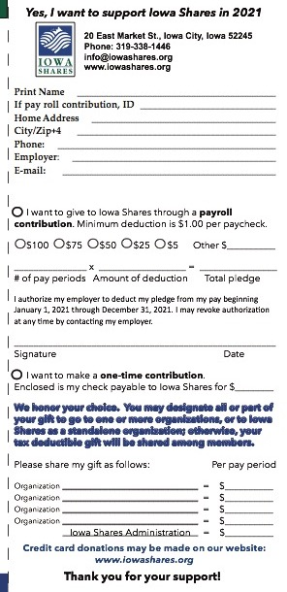
How to Donate to IS?
Complete the tear-out section of the campaign brochure and return it to IS office.
  Brochures are available from your IS contact. Electronic file can be downloaded from IS homepage: https://www.iowashares.org/
Donate through the IS iPledge website https://www.ipledgeonline.org/_iowasharesonline/
Use workplace internal campaign form or system and forward results to IS office.

Slide 12

Thank you !
If you have any questions, please contact Iowa Shares at 319-338-1446 or info@iowashares.org

